Slide 1
Probabilistic Machine Learning Parameter Estimation: MAP and Bayesian Inference
CSN-382

Slide 2
MLE and Its Shortcomings..
MLE finds parameters that make the observed data most probable
No provision to control overfitting (MLE is just like minimizing training loss)
How do we regularize probabilistic models in a principled way?
Also, MLE gives only a single “best” answer (“point estimate”)
.. and it may not be very reliable, especially when we have very little data
Desirable: Report a probability distribution over the learned params instead of point est
Prior distributions provide a nice way to accomplish such things!
Log-likelihood
Neg. log-likelihood (NLL)
$$θ_{MLE}= arg\max_{θ}\sum_{n=1}^{N}{log p\left(y_{n} | θ\right) }\text{= }arg\min_{θ}\sum_{n=1}^{N}{−log p\left(y_{n} | θ\right) }$$
This distribution can give us a sense about the uncertainty in the parameter estimate

Slide 3

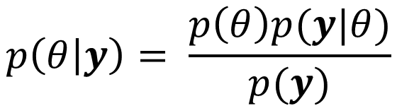





Priors
Can specify our prior belief about likely param values via a prob. dist., e.g.,
Once we observe the data $y$, apply Bayes rule to update prior into posterior
Two way now to report the answer now:
Report the maxima (mode) of the posterior: $arg \max_{θ} p\left(θ | y\right)$
Report the full posterior (and its properties, e.g., mean, mode, variance, quantiles, etc)
This is a rather simplistic/contrived prior. ☺ Just to illustrate the basic idea. We will see more concrete examples of priors shortly. Also, the prior usually depends (assumed conditioned on) on some fixed/learnable hyperparameters (say some $α$and $β$ , and written as $p(θ|α,β)$
$$p(θ)$$
A possible prior for the coin bias estimation problem. The unknown $θ$is being treated as a random variable, not simply a fixed unknown as we treated it as in MLE
0
0.25
0.5
0.75
1
$$θ$$
Prior
Likelihood
$$p\left(θ | y\right)= \frac{p\left(θ\right)p(y|θ)}{p(y)}$$
Note: Marginal lik. is hard to compute in general as it requires a summation or integral which may not be easy
Posterior
Marginal likelihood
Maximum-a-posteriori (MAP) estimation
Fully Bayesian inference
Notes:
Prior is a belief over parameters (\theta)

Slide 4


Posterior
Posterior distribution tells us how probable different parameter values are after we have observed some data
Height of posterior at each value gives the posterior probability of that value
Can think of the posterior as a “hybrid” obtained by combining information from the likelihood and the prior
$$p(θ|y)$$
More likely values
Less likely values
0
0.25
0.5
0.75
1
$$θ$$

Slide 5


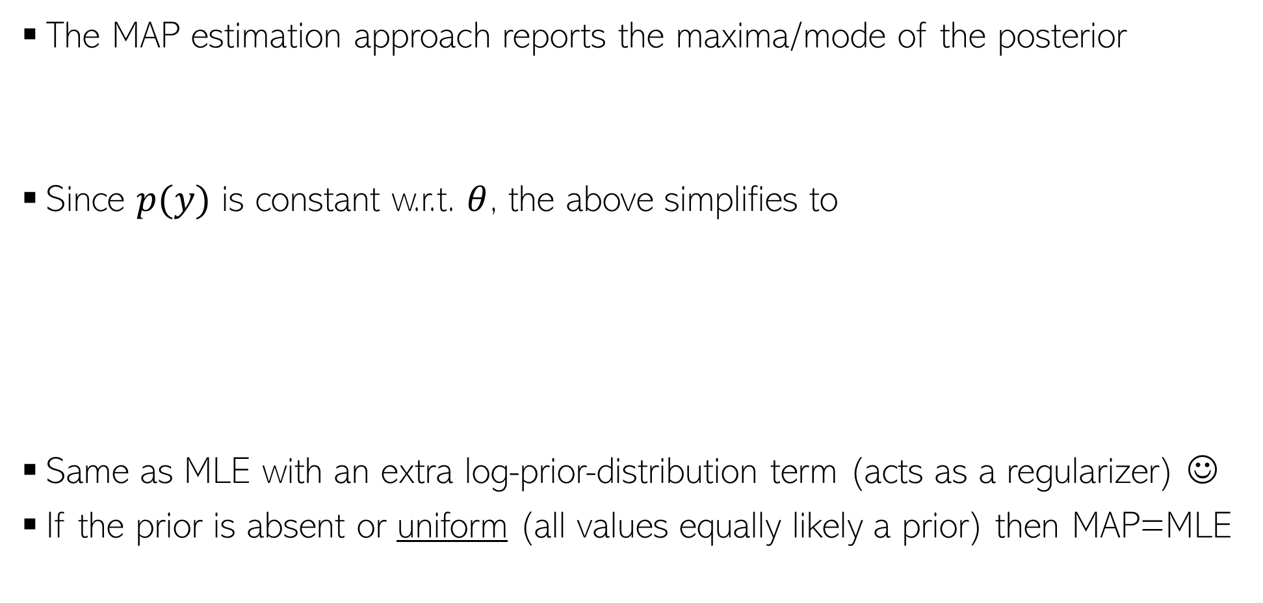

Maximum-a-Posteriori (MAP) Estimation
The MAP estimation approach reports the maxima/mode of the posterior
Since $p(y)$ is constant w.r.t. $θ$, the above simplifies to
Same as MLE with an extra log-prior-distribution term (acts as a regularizer) ☺
If the prior is absent or uniform (all values equally likely a prior) then MAP=MLE
$$θ_{MAP}=arg \max_{θ}p\left(θ | y\right)=arg\max_{θ}log p\left(θ | y\right)=arg\max_{θ}log \frac{p\left(θ\right)p(y|θ)}{p(y)}$$
$$θ_{MAP}=arg\max_{θ}[log p\left(y | θ\right)+ log p\left(θ\right)]$$
The NLL term acts like the training loss and the (negative) log-prior acts as regularizer. Keep in mind this analogy. ☺
$$=arg\min_{θ}[−log p\left(y | θ\right)− log p\left(θ\right)]$$
$$θ_{MAP} =arg\min_{θ}[NLL(θ)− log p\left(θ\right)]$$
Notes:
We want the value of parameters such that NLL will get minimized but the values must be close to the prior distribution as well.

Slide 6
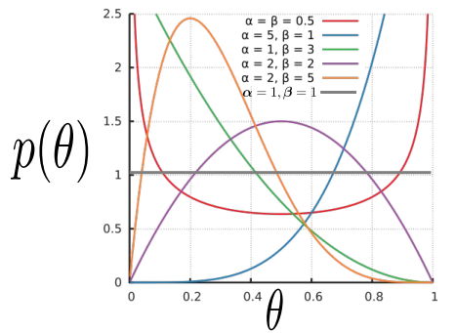
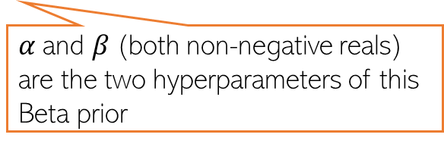
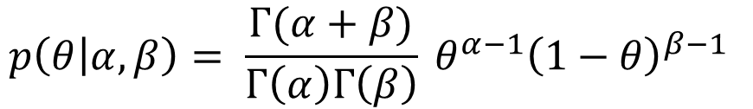


MAP Estimation: An Example
Let’s again consider the coin-toss problem (estimating the bias of the coin)
Each likelihood term is Bernoulli
Also need a prior since we want to do MAP estimation
Since $θ∈ (0,1)$, a reasonable choice of prior for $θ$would be Beta distribution
$$p\left(y_{n} | θ\right)=Bernoulli\left(y_{n} | θ\right)= θ^{y_{n}} {(1−θ)}^{1−y_{n}}$$
$$p\left(θ | α,β\right)= \frac{Γ(α+β)}{Γ\left(α\right)Γ\left(β\right)} θ^{α−1}{\left(1−θ\right)}^{β−1 }$$
The gamma function
$α$and $β$(both non-negative reals) are the two hyperparameters of this Beta prior
Using $α=1$and $β=1$will make the Beta prior a uniform prior
Can set these based on intuition, cross-validation, or even learn them

Slide 7
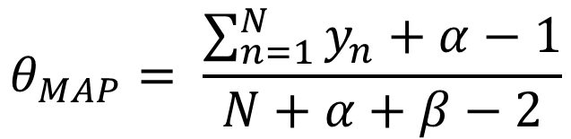
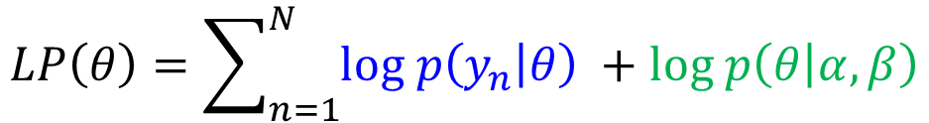
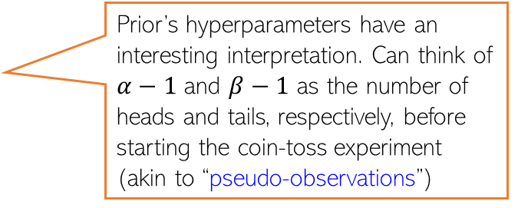

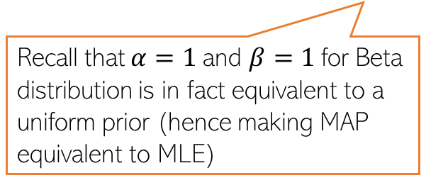

MAP Estimation: An Example (Contd)
The log posterior for the coin-toss model is log-lik + log-prior
Plugging in the expressions for Bernoulli and Beta and ignoring any terms that don’t depend on $θ$, the log posterior simplifies to
Maximizing the above log post. (or min. of its negative) w.r.t. 𝜃 gives
$$LP\left(θ\right)=\sum_{n=1}^{N}{log p\left(y_{n} | θ\right) }+log p\left(θ | α,β\right)$$
$$LP\left(θ\right)=\sum_{n=1}^{N}{\left[y_{n}log θ+\text{ (}1−y_{n}\right)log\left(1−θ\right)]+}\left(α−1\right)log θ+\left(β−1\right)log(1−θ)$$
Prior’s hyperparameters have an interesting interpretation. Can think of $α−1$ and $β−1$ as the number of heads and tails, respectively, before starting the coin-toss experiment (akin to “pseudo-observations”)
Using $α=1$and $β=1$gives us the same solution as MLE
$$θ_{MAP}= \frac{\sum_{n=1}^{N}{y_{n}+α−1}}{N+α+β−2}$$
Recall that $α=1$and $β=1$for Beta distribution is in fact equivalent to a uniform prior (hence making MAP equivalent to MLE)
Such interpretations of prior’s hyperparameters as being “pseudo-observations” exist for various other prior distributions as well (in particular, distributions belonging to “exponential family” of distributions

Slide 8
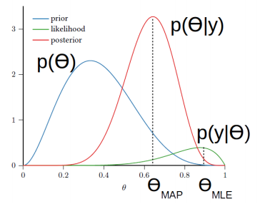
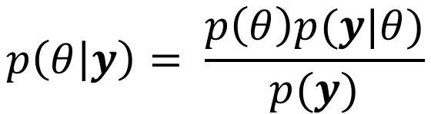

Fully Bayesian Inference
MLE/MAP only give us a point estimate of $θ$
If we want more than just a point estimate, we can compute the full posterior
Interesting fact to keep in mind: Note that the use of the prior is making the MLE solution move towards the prior (MAP solution is kind of a “compromise between MLE solution of the mode of the prior) ☺
MAP estimate is more robust than MLE (due to the regularization effect) but the estimate of uncertainty is missing in both approaches – both just return a single “optimal” solution by solving an optimization problem
Fully Bayesian inference
Computable analytically only when the prior likelihood are “friends” with each other (i.e., they form a conjugate pair of distributions (distributions from exponential family have conjugate priors
$$p\left(θ | y\right)= \frac{p\left(θ\right)p(y|θ)}{p(y)}$$
In other cases, the posterior needs to be approximated (will see 1-2 such cases in this course; more detailed treatment in the advanced course on probabilistic modeling and inference)
An example: Bernoulli and Beta are conjugate. Will see some more such pairs
Notes:
If the prior and the posterior belong to the same parametric family, then the prior is said to be conjugate for the likelihood. https://www.statlect.com/fundamentals-of-statistics/conjugate-prior

Slide 9
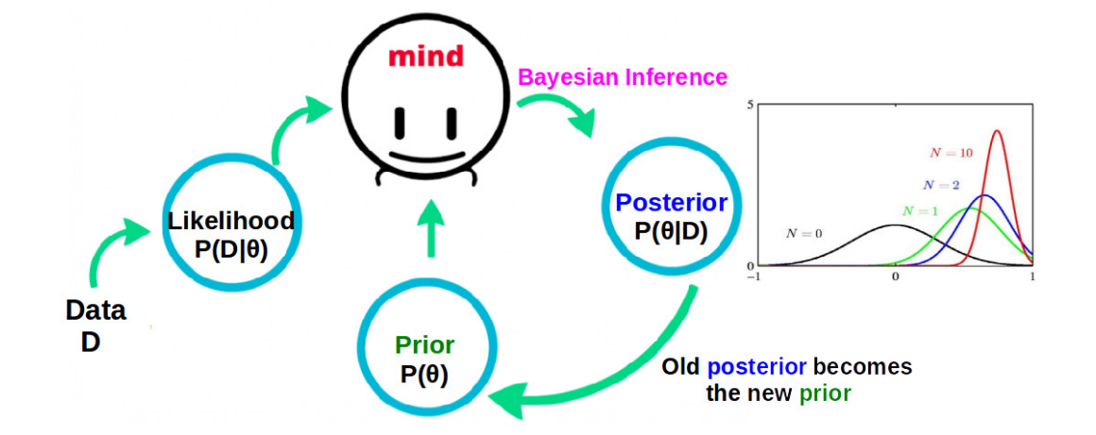

“Online” Nature of Bayesian Inference
Fully Bayesian inference fits naturally into an “online” learning setting
Our belief about $θ$ keeps getting updated as we see more and more data
Also, the posterior becomes more and more “concentrated” as the number of observations increases. For very large N, you may expect it to be peak around the MLE solution

Slide 10
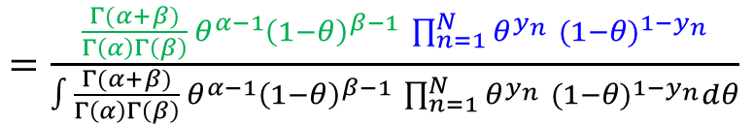
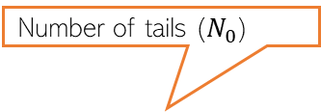
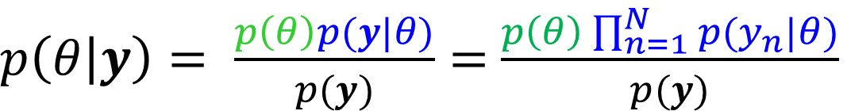
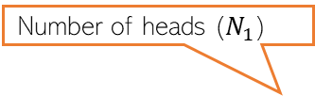

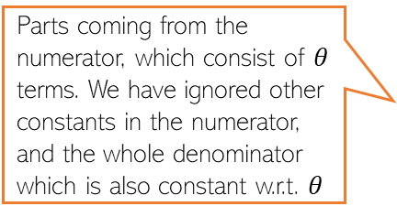


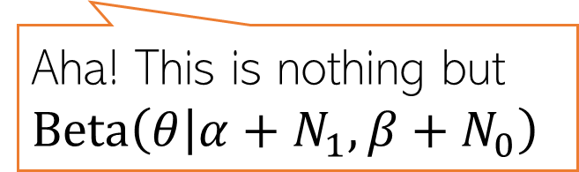
Fully Bayesian Inference: An Example
Posterior is the same distribution as the prior (both Beta), just with updated hyperparameters (property when likelihood and prior are conjugate to each other)
Also, if you get more observations, you can treat the current posterior as the new prior and obtain a new posterior using these extra observations
Let’s again consider the coin-toss problem
Bernoulli likelihood: $p\left(y_{n} | θ\right)=Bernoulli\left(y_{n} | θ\right)= θ^{y_{n}} {(1−θ)}^{1−y_{n}}$
Beta prior: $p\left(θ\right)=Beta\left(θ | α, β\right)= \frac{Γ(α+β)}{Γ\left(α\right)Γ\left(β\right)} θ^{α−1}{\left(1−θ\right)}^{β−1 }$
The posterior can be computed as
Number of heads ($N_{1}$)
Number of tails ($N_{0}$)
$$θ^{\sum_{n=1}^{N}{y_{n}}} {(1−θ)}^{N−\sum_{n=1}^{N}{y_{n}}}$$
$p\left(θ | y\right)= \frac{p\left(θ\right)p(y|θ)}{p(y)}=$ $\frac{p\left(θ\right)\prod_{n=1}^{N}{p(y_{n}|θ)}}{p(y)}$
$=\frac{\frac{Γ(α+β)}{Γ\left(α\right)Γ\left(β\right)} θ^{α−1}{\left(1−θ\right)}^{β−1 }\prod_{n=1}^{N}{θ^{y_{n}} {(1−θ)}^{1−y_{n}}}}{∫\frac{Γ(α+β)}{Γ\left(α\right)Γ\left(β\right)} θ^{α−1}{\left(1−θ\right)}^{β−1 }\prod_{n=1}^{N}{θ^{y_{n}} {(1−θ)}^{1−y_{n}}}dθ}$
Parts coming from the numerator, which consist of $θ$ terms. We have ignored other constants in the numerator, and the whole denominator which is also constant w.r.t. $θ$
This is the numerator integrated/marginalized over $θ :$ $p\left(y\right) =∫p\left(θ, y\right)dθ=∫p\left(θ\right)p\left(y | θ\right)dθ$
In general, hard but with conjugate pairs of prior and likelihood, we don’t need to compute this, as we will see in this example ☺
$∝θ^{α+N_{1}−1}{{\left(1−θ\right)}^{β+N_{0}−1}}^{ }$
Aha! This is nothing but $Beta\left(θ | α+N_{1}, β+N_{0}\right)$
This, of course, is not always possible but only in simple cases like this
Found the posterior just by simple inspection without having to calculate the constant of proportionality ☺

Slide 11
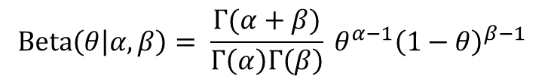

Conjugacy
Many pairs of distributions are conjugate to each other
Bernoulli (likelihood) + Beta (prior) ⇒ Beta posterior
Binomial (likelihood) + Beta (prior) ⇒ Beta posterior
Multinomial (likelihood) + Dirichlet (prior) ⇒ Dirichlet posterior
Poisson (likelihood) + Gamma (prior) ⇒ Gamma posterior
Gaussian (likelihood) + Gaussian (prior) ⇒ Gaussian posterior
and many other such pairs ..
Tip: If two distr are conjugate to each other, their functional forms are similar
Example: Bernoulli and Beta have the forms
Not true in general, but in some cases (e.g., when mean of the Gaussian prior is fixed)
This is why, when we multiply them while computing the posterior, the exponents get added and we get the same form for the posterior as the prior but with just updated hyperparameter. Also, we can identify the posterior and its hyperparameters simply by inspection
$$Bernoulli\left(y | θ\right)= θ^{y} {(1−θ)}^{1−y}$$
$$Beta\left(θ | α, β\right)= \frac{Γ(α+β)}{Γ\left(α\right)Γ\left(β\right)} θ^{α−1}{\left(1−θ\right)}^{β−1 }$$

Slide 12



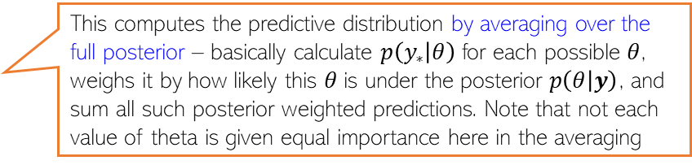



Probabilistic Models: Making Predictions
For example, PMF of the label of a new test input in classification
Having estimated $θ$, we can now use it to make predictions
Prediction entails computing the predictive distribution of a new observation, say $y_{∗}$
When doing MLE/MAP, we approximate the posterior $p(θ|y)$by a single point $θ_{opt}$
When doing fully Bayesian est, getting the predictive dist. Will require computing
$$p\left(y_{∗} | y\right)=∫p\left(y_{∗},θ | y\right)dθ$$
Marginalizing over the unknown $θ$
$$=∫p\left(y_{∗} | θ, y\right)p(θ|y)dθ$$
Decomposing the joint using chain rule
Conditional distribution of the new observation, given past observations
$$=∫p\left(y_{∗} | θ\right)p(θ|y)dθ$$
Assuming i.i.d. data, given $θ$, $y_{∗}$ does not depend on $y$
$$p\left(y_{∗} | y\right)=∫p\left(y_{∗} | θ\right)p\left(θ | y\right)dθ≈p(y_{∗}|θ_{opt})$$
A “plug-in prediction” (simply plugged in the singe estimate we had)
This computes the predictive distribution by averaging over the full posterior – basically calculate $p\left(y_{∗} | θ\right)$ for each possible $θ$, weighs it by how likely this $θ$is under the posterior $p\left(θ | y\right)$, and sum all such posterior weighted predictions. Note that not each value of theta is given equal importance here in the averaging
$$p\left(y_{∗} | y\right)=∫p\left(y_{∗} | θ\right)p\left(θ | y\right)dθ$$
$$𝔼_{p\left(θ | y\right)}[p\left(y_{∗} | θ\right)]$$

Slide 13


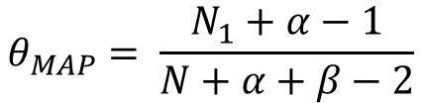
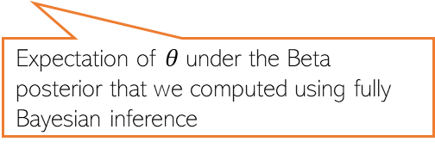

Probabilistic Models: Making Predictions (Example)
For coin-toss example, let’s compute probability of the ${\left(N+1\right)}^{th}$toss showing head
This can be done using the MLE/MAP estimate, or using the full posterior
Thus for this example (where observations are assumed to come from a Bernoulli)
$$θ_{MLE}= \frac{N_{1}}{N}$$
$$θ_{MAP}= \frac{N_{1}+α−1}{N+α+β−2}$$
$$p\left(θ | y\right)= Beta\left(θ | α+N_{1}, β+N_{0}\right)$$
Again, keep in mind that the posterior weighted averaged prediction used in the fully Bayesian case would usually not be as simple to compute as it was in this case. We will look at some hard cases later
Expectation of $θ$under the Beta posterior that we computed using fully Bayesian inference

Slide 14
Probabilistic Modeling: A Summary
Likelihood corresponds to a loss function; prior corresponds to a regularizer
Can choose likelihoods and priors based on the nature/property of data/parameters
MLE estimation = unregularized loss function minimization
MAP estimation = regularized loss function minimization
Allows us to do fully Bayesian learning (learning the full distribution of the parameters)
Makes robust predictions by posterior averaging (rather than using point estimate)
Many other benefits, such as
Estimate of confidence in the model’s prediction (useful for doing Active Learning)
Can do automatic model selection, hyperparameter estimation, handle missing data, etc.
Formulate latent variable models
.. and many other benefits (a proper treatment deserves a separate course, but we will see some of these in this course, too)
Notes:
MAP Is more robust than MLE

